Slide 1

FocusLens
Real-Time Student Engagement and Attention Monitor
Iman Haamid
Midterm Project Proposal – ITAI 1378: Computer Vision and AI

Slide 2

Problem: Lack of Student Engagement
Solution: FocusLens
Real-time monitoring of student engagement
Computer vision detects attention and focus
Provides instructors with immediate valuable feedback
Optimized learning environment through data insights

Slide 3

What will your system do?
Monitor a student's attentiveness during online lectures using computer vision on a webcam feed.
How will it solve the problem?
Track facial features and eye closure to classify the student's status as Attentive, Drowsy, or Absent.
Example:
Face Detection
Reliably locate the user's face in every frame using Object Detection.
Facial Landmark Detection
Identify and track 6 key points around each eye for the primary engagement metric.
Eye Aspect Ratio (EAR) Calculation
The core metric: a ratio from eye landmarks. Small EAR = closed eye; large EAR = open eye.
Attentiveness Status
Use EAR and face presence to classify status into three states: Attentive, Drowsy, or Absent.
Solutions - FocusLens

Slide 4

Technical Tools and Models
Object detection and landmark identification drive the system's core function.
The proposed solution utilizes Dlib for robust face and landmark detection.
Core frameworks include Python, OpenCV, NumPy, and Pandas for processing.
Python is the primary language, standard for computer vision and machine learning.
Matplotlib or Streamlit will be used for final data visualization and reporting.

Slide 5

Data Collection and Plan
Source a public computer vision dataset for the project.
The dataset size needs to be determined and justified soon.
Labels will include Attentive, Drowsy, and Absent classifications.
Data preparation includes labeling and cleaning the selected images.

Slide 6
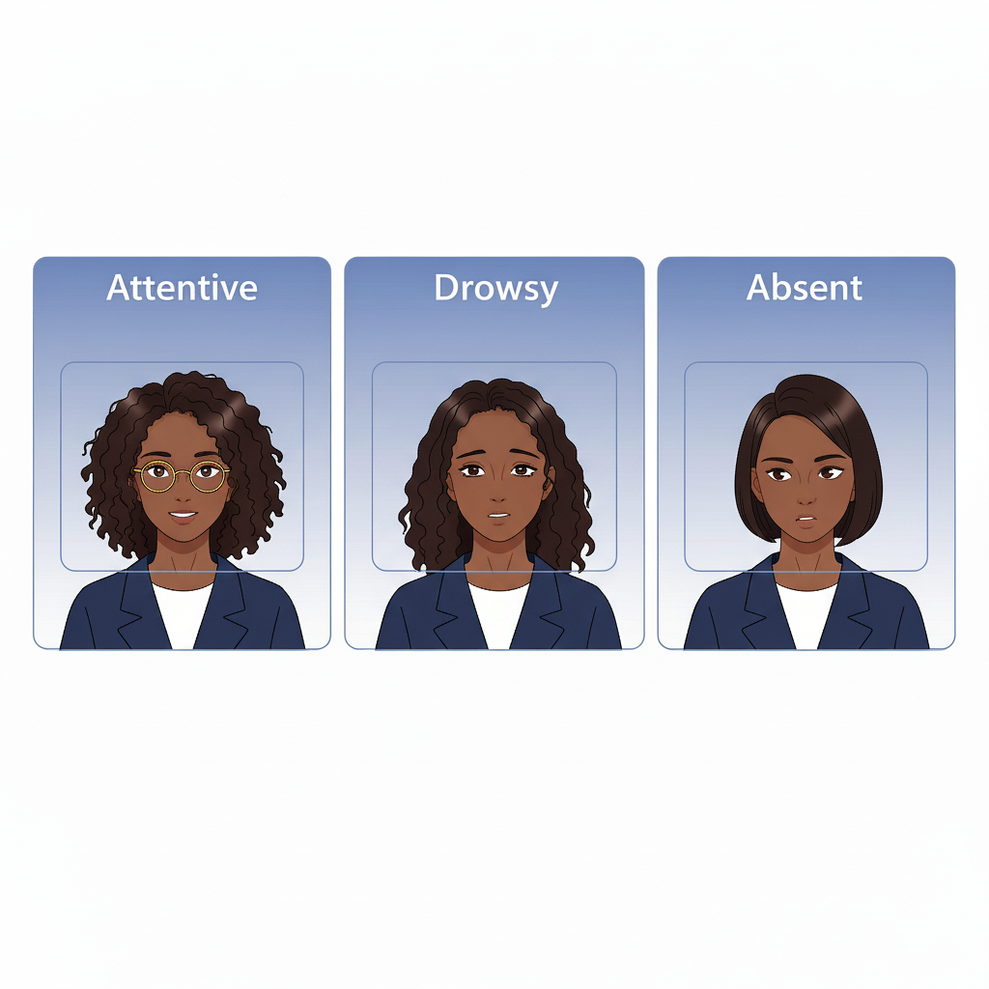
Project Resources and Tools
The FocusLens data source can be a public dataset or a new collection
The required size needs to be carefully determined and fully justified
Data preparation includes cleaning and labeling the selected images
Classification labels must include Attentive, Drowsy, and Absent statuses

Slide 7
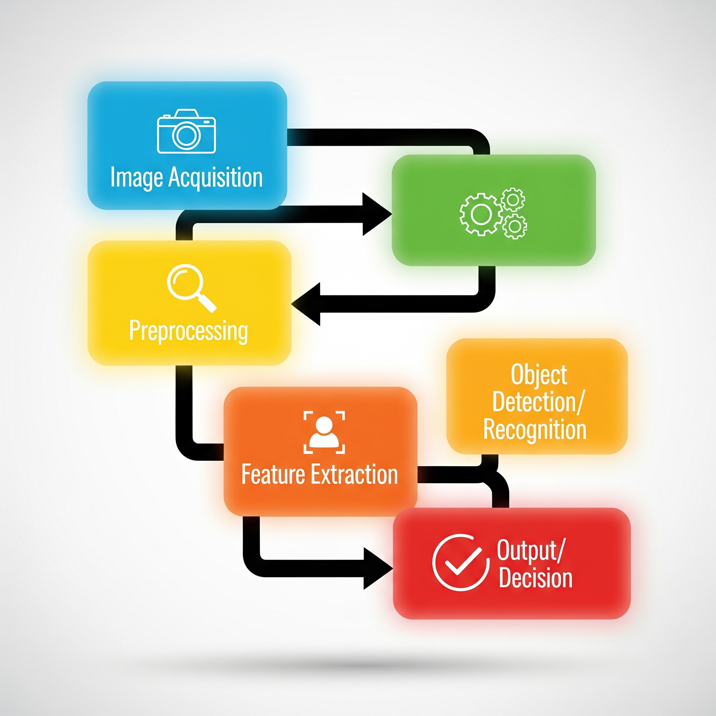
System Flow Pipeline
Webcam acquires video frame input continuously
Frame undergoes initial processing and object detection
Facial landmarks and eye regions are precisely analyzed
System calculates Eye Aspect Ratio for attentiveness status
Real-time attentiveness status is provided as the final output

Slide 8

Measuring Project Success
Achieve high accuracy, precision, and recall scores
Target a primary metric performance of ninety percent
Ensure secondary metric speed is less than one second
Minimize image latency to optimize system performance

Slide 9
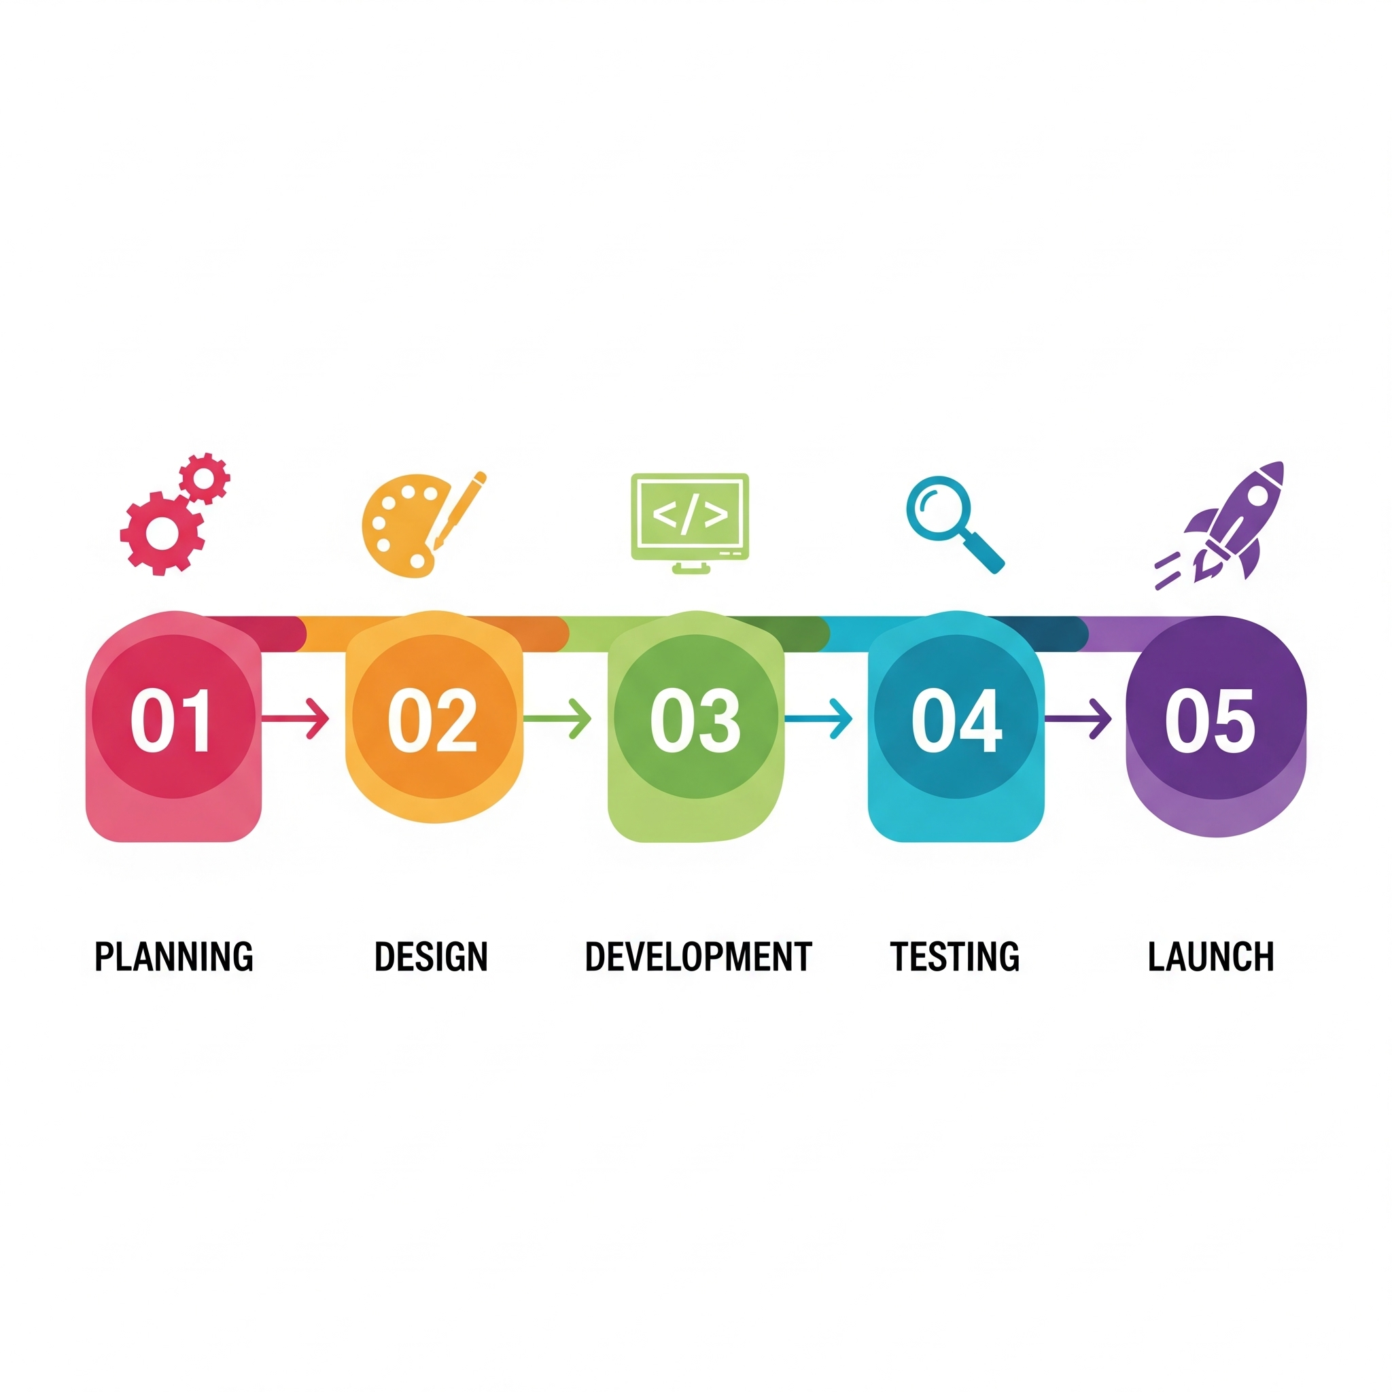
Project Timeline: 5 Weeks
Week one - focuses on core system setup and detection
Week two - Real-time Eye Aspect Ratio calculation is the focus
Week three - involves implementing the final engagement status logic
Week four - Data logging and the final report generation are scheduled.
The last week is dedicated to code cleaning and final submission

Slide 10

Project Resources: Tools
FocusLens requires minimal external resources
Cloud compute options include Colab and Kaggle
Frameworks like PyTorch can power the models
The estimated project cost is extremely low

